Slide 1
Sepsis Management
Implementing SSC Guidelines and Meeting CMS Metrics

Slide 2
Sepsis Management
Implementing SSC Guidelines and Meeting CMS Metrics
Moderator
Ebrahim Barkoudah, MD, MPH, FACP, SFHM
Brigham and Women’s Hospital
Harvard Medical School
Dr. Barkoudah reports research support payments from National Institutes of Health/National Heart, Lung, and Blood Institute, Bristol Myers Squibb and Janssen, payments made to Brigham and Women's Hospital for performing clinical endpoints sponsored by various entities, payments from WebMD and Advisory Board fees from Medscape, Janssen, Novartis, Pfizer, and travel expenses from Alexion.

Slide 3
Sepsis Management
Implementing SSC Guidelines and Meeting CMS Metrics
Jose R. Mercado, MD
Assistant Professor of Medicine, Geisel School of Medicine
Associate Medical Director, Care Management and Utilization Management Dartmouth- Hithcock
Medical Director, Alice Peck Day Hospital
Regional Medical Director of Inpatient Quality, Dartmouth Health
SHM Education Committee
SHM Quality Improvement SIG Executive Council

Slide 4
Attestation Disclosure to the Audience
The activity director(s), planning committee member(s), speaker(s), author(s) or anyone in a position to control the content for the Sepsis Management- Implementing SSC Guidelines and Meeting CMS metrics have reported NO financial interest or relationship which could be perceived as a real or apparent conflict of interest. There were no individuals in a position to control the content that refused to disclose.

Slide 5
Clinical Vignette
60 year old woman with history of COPD presents with 4 days of fever, cough, and shortness of breath. Temp 101F, HR 115, BP 96/65, RR 26, 91% on 5L/NC. Lungs with coarse breath sounds. Extremities were warm. WBC 16K (23% bands). Serum creatinine of 4 (baseline 1.1) What is your diagnosis?
SIRS
Sepsis
Severe sepsis
Septic shock
Multi-Organ Dysfunction Syndrome

Slide 6
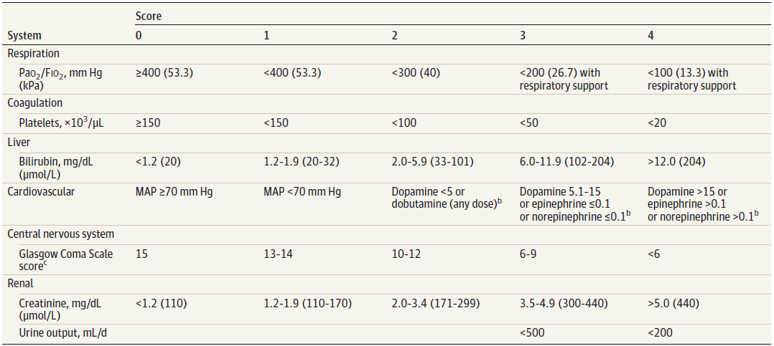
Definition
Sepsis is a life-threatening condition that arises when the body’s response to and infection injures its own tissues and organs
    Organ dysfunction can be identified as an acute change in total SOFA score > 2 points consequent to the infection
Septic shock is the subset of sepsis with circulatory and cellular/ metabolic dysfunction which is associated with higher mortality
    Need for vasopressors to keep MAP > 65 mmHg, and lactate > 2 mmol/L despite volume resuscitation,
M Singer et al. JAMA. 2016;315(8):801-810. doi:10.1001/jama.2016.0287
Notes:
Reliance on general systemic manifestations, manifestations of organ dysfunction/failure, and, finally, microbiological documentation.
A SOFA score2 reflects an overall mortality risk of approximately 10% in a general hospital population with suspected infection. Septic shock 46-70% mortality

Slide 7
Screening for Sepsis
PICO Question | 2021 Recommendation | Recommendation Strength and Quality
In acutely ill patients, should we use qSOFA criteria to screen for the presence of sepsis? | We recommend against using qSOFA compared with SIRS, NEWS, or MEWS as a single screening tool for sepsis and septic shock | Strong recommendation Moderate quality of evidence
For Clinicians | Most individuals should receive the recommended course of action Formal decision aids are not likely to be needed

Slide 8
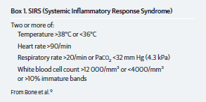
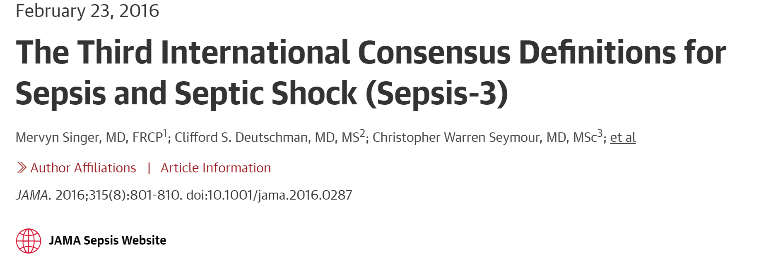

Screening for Sepsis

Slide 9
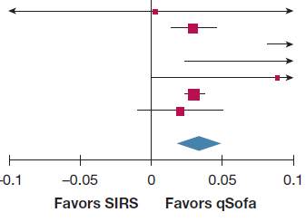
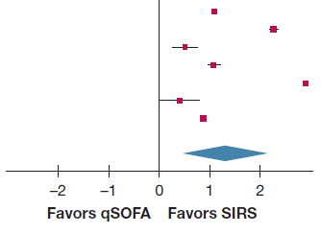
Two step approach; highly sensitive screening tool for diagnosis (SIRS) and a better predictor of outcome for resource allocation (qSOFA)
Mortality
Diagnosis of Sepsis
R. Serafim et al. CHEST 2018; 153(3):646-655
Notes:
One in every three patients with Sepsis-3 septic shock did not meet the qSOFA criteria.

Slide 10
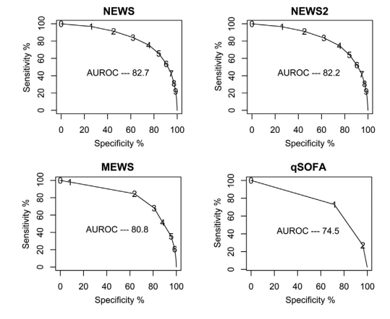
Early Warning Scores
Clinical decision support
Low alert volumes
Integrate into the clinical workflow
Staged response that trend examination of scores and bedside evaluation (severity categories)
    What is the score?
    Is there a concern for infection?
S.P. McGrath et al. Improvement of sepsis identification through multi-year comparison of sepsis and early warning scores. American Journal of Emergency Medicine 51 (2022) 239–247

Slide 11
Clinical Vignette
60 year old woman with history of COPD presents with 4 days of fever, cough, and shortness of breath. Temp 99F, HR 110, BP80/50, RR 28, 91% on 5L/NC. Lungs with coarse breath sounds. Capillary refill time > 3. WBC 16K (23% bands). Serum creatinine of 4 (baseline 1.1). Lactic acid of 4. What is your best next step?
IV fluid bolus 500 ml of lactated ringer
Start broad spectrum antibiotics
Add vasopressors if MAP not > 65
All of the above

Slide 12
Initial Resuscitation
PICO Question | 2021 Recommendation | Recommendation Strength and Quality
In patients with known or suspected infection and/or hypotension and/or an elevated lactate should we administer 30ml/kg BW of crystalloids or a rapid small volume fluid challenge and reassess? | For patients with sepsis induced hypoperfusion or septic shock we suggest that at least 30 mL/kg of IV crystalloid fluid should be given within the first 3 hrs of resuscitation. | Weak recommendation Low quality of evidence
Lactate | We suggest guiding resuscitation to decrease the serum lactate in patients with elevated lactate level, over not using serum lactate
Capillary refill time | We suggest using capillary refill time to guide resuscitation as an adjunct to other measures of perfusion
For Clinicians | Requires shared decision making and consideration for patients’ or family’s values and preferences

Slide 13
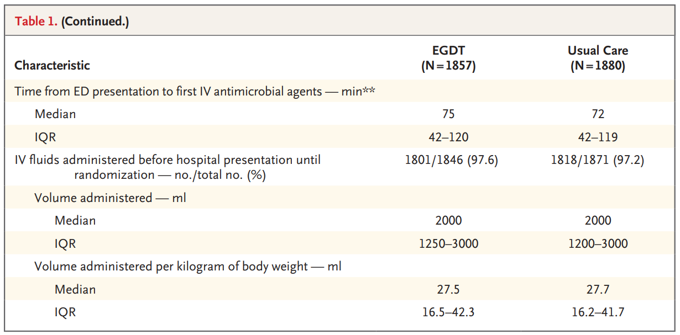
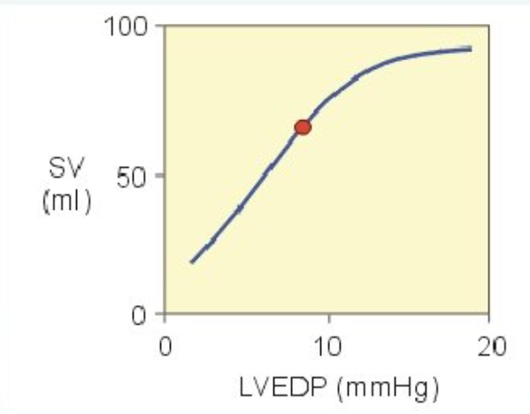
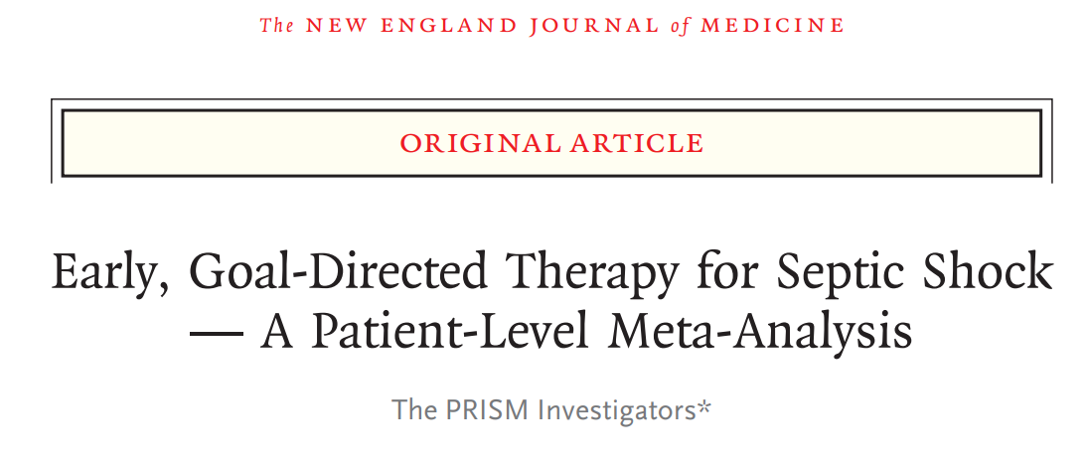
Initial Resuscitation
K.M. Rowan et al. N Engl J Med 2017; 376:2223-2234
Notes:
There was no significant difference in the duration of survival to 1 year between the group that received early, goal-directed therapy (EGDT) and the group that received usual care.

Slide 14
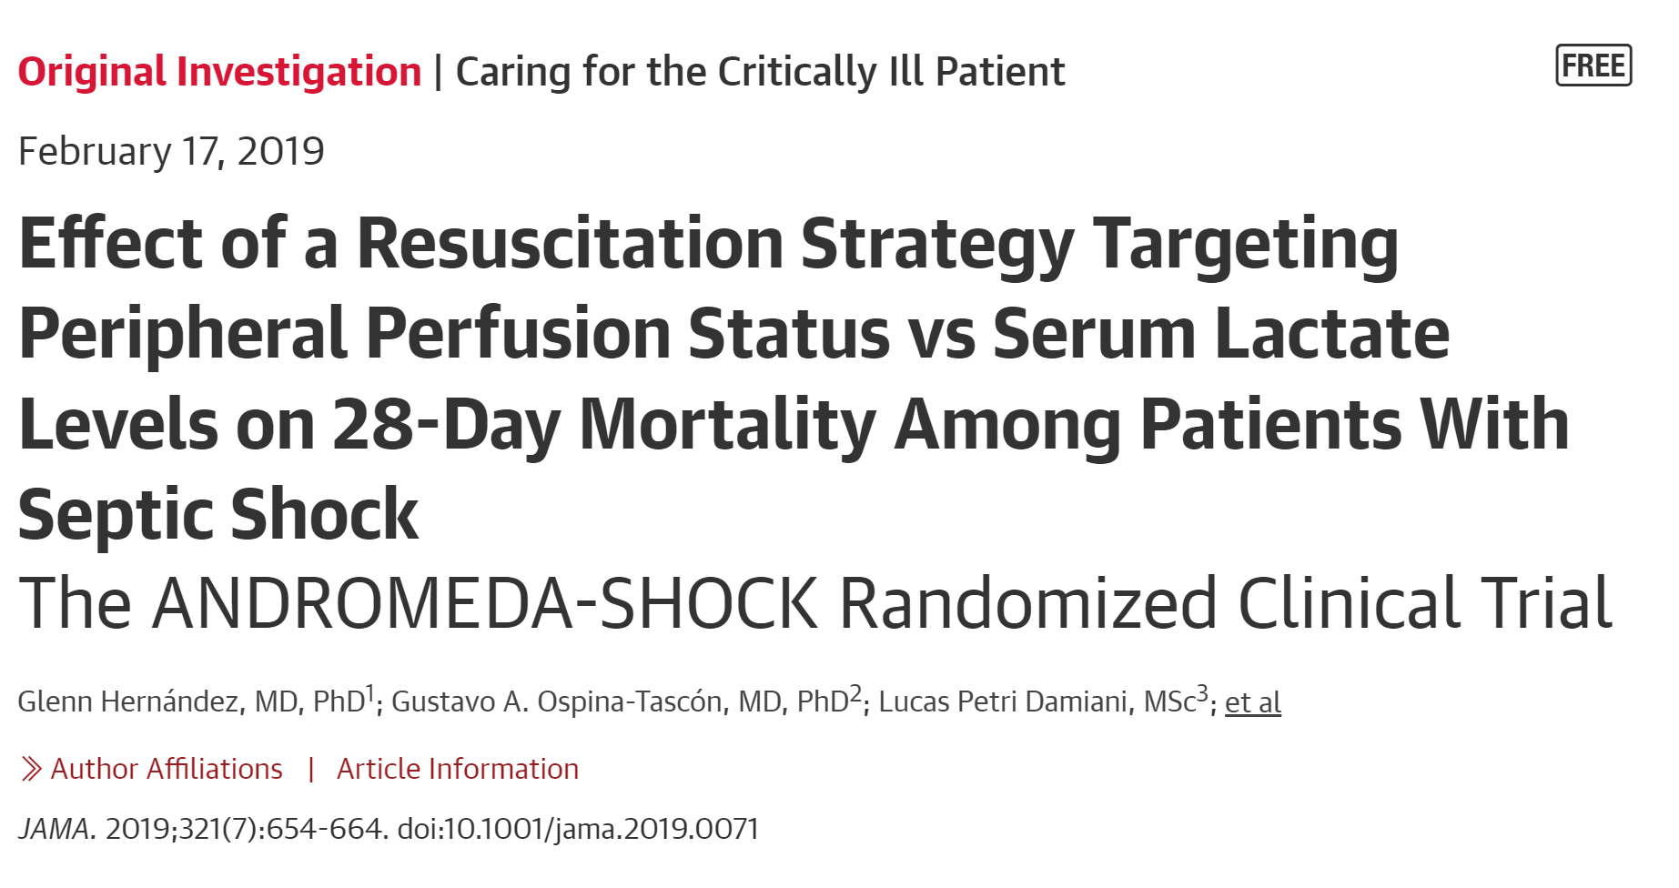
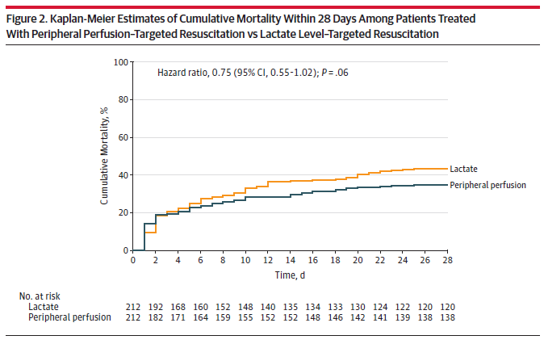
Initial Resuscitation
A peripheral perfusion–targeted resuscitation strategy did not result in a significantly lower 28-day mortality when compared with a lactate level–targeted strategy.

Slide 15
Cardiac Output = Stroke Volume x Heart Rate
Hypotensive
CRT > 3, MAP < 65, lactate > 4
IVF bolus 500ml/15mins
20-30 ml/kg
Vasopressors
Empiric Antibiotics
Empiric Antibiotics

Slide 16
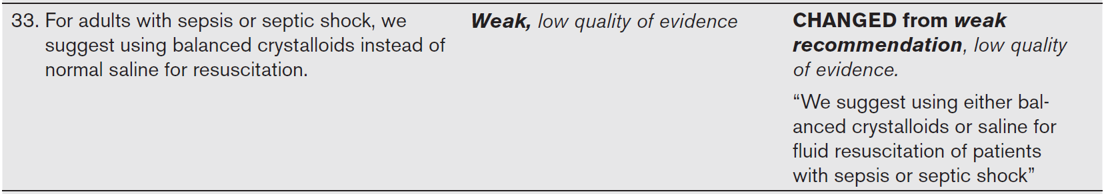
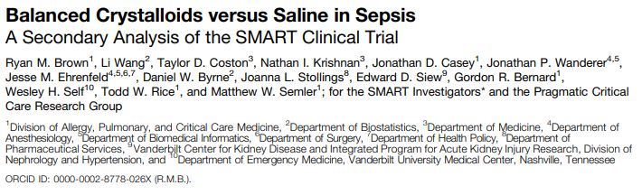
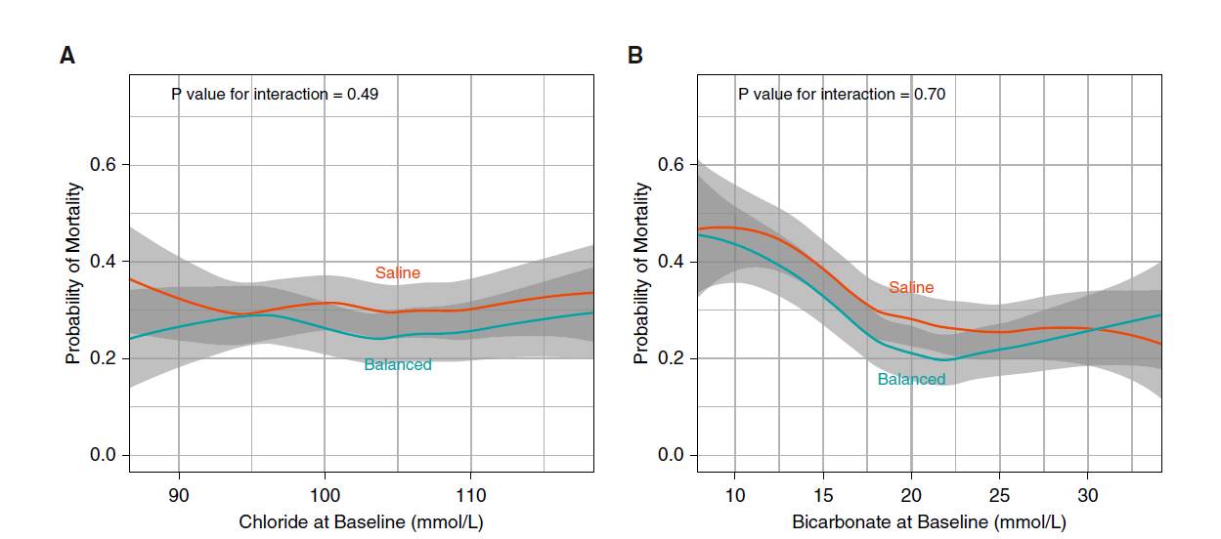
Hemodynamic Management

Slide 17
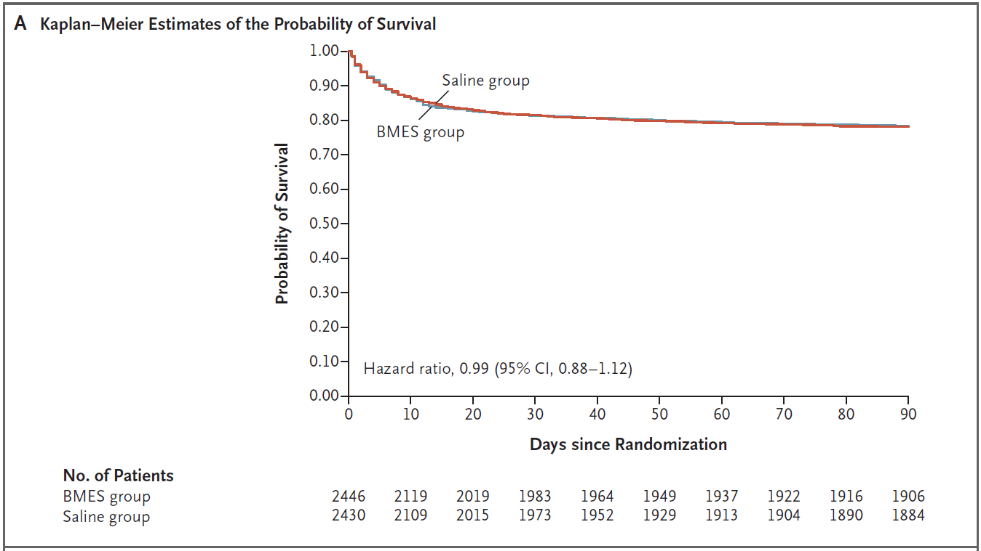
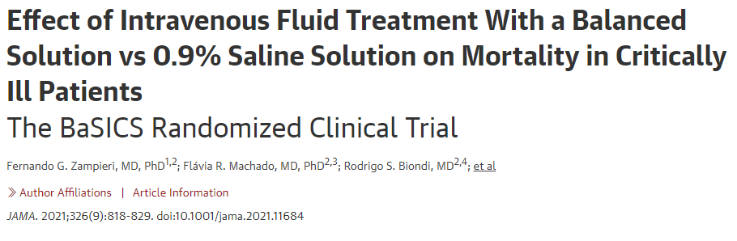
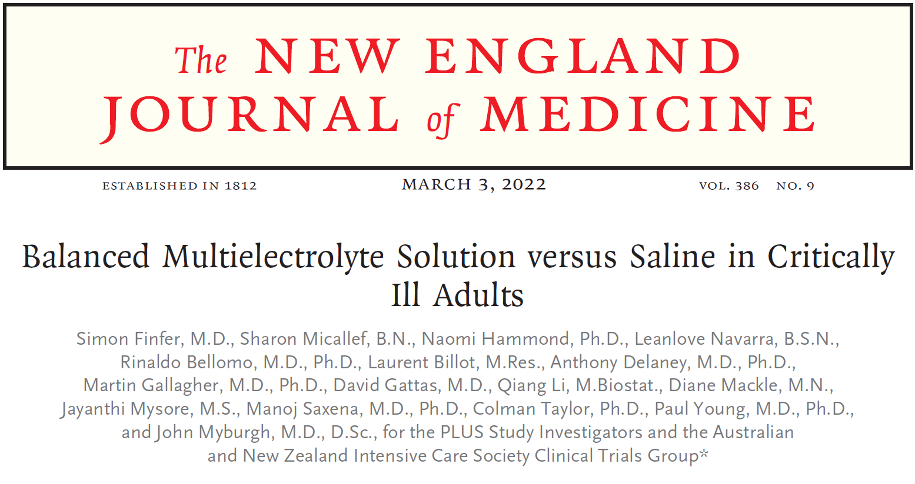
Hemodynamic Management
Individual patient characteristics (acid base balance)
Cost and availability of the fluids
Drug compatibility

Slide 18


Slide 19

Antibiotics in Early Sepsis: Understanding the Data Behind What We Do
Michael S. Calderwood, MD MPH
Chief Quality Officer, Dartmouth-Hitchcock Medical Center
Associate Professor of Medicine, Geisel School of Medicine at Dartmouth
Staff Physician, Section of Infectious Disease and International Health

Slide 20
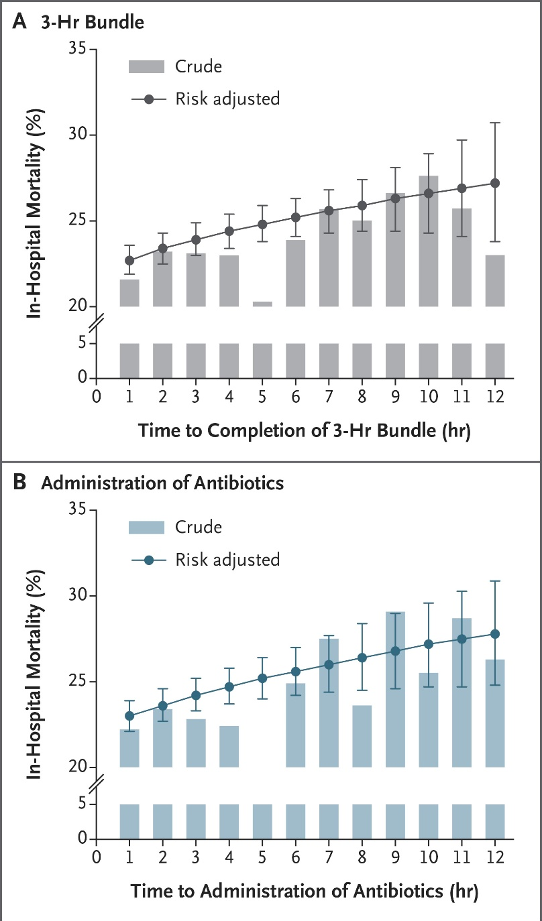
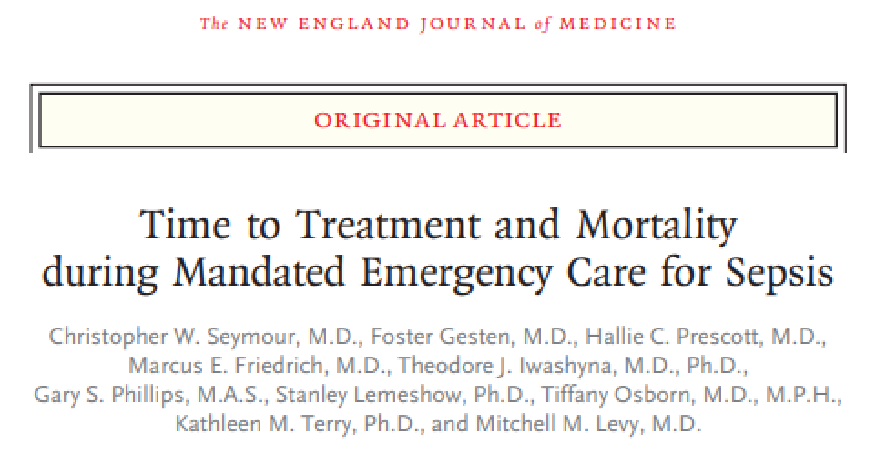
The push for early antibiotics…
N Engl J Med 2017;376:2235.

Slide 21
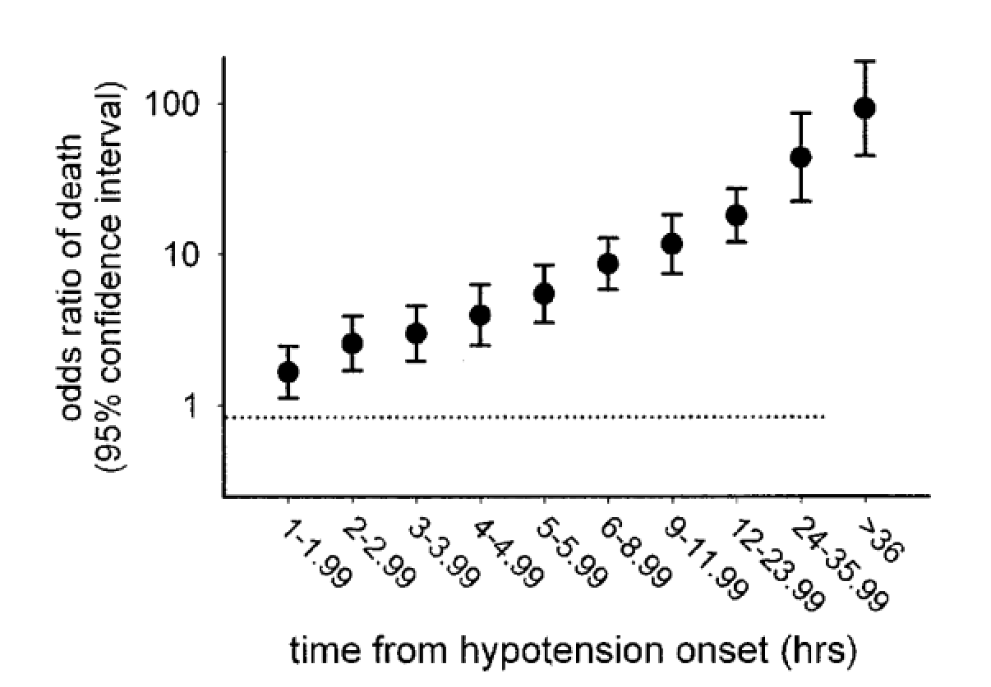
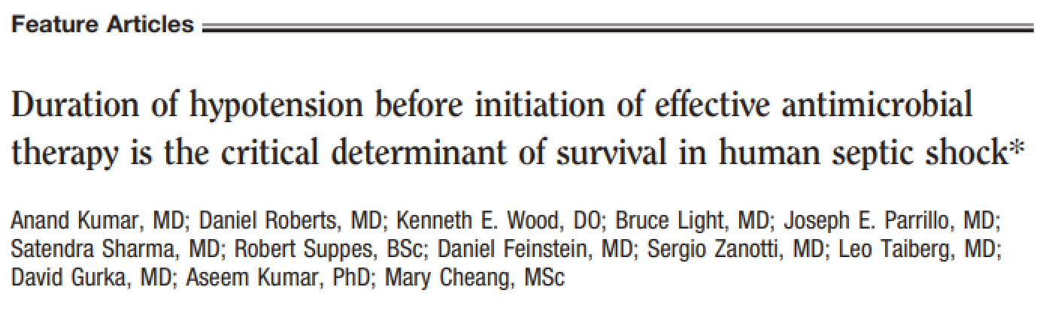
However, data are really for patients with septic shock and time-to-antibiotics after persistent or recurrent hypotension
Crit Care Med 2006;34:1589.

Slide 22
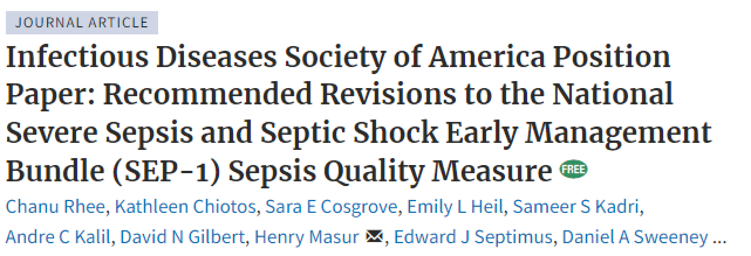
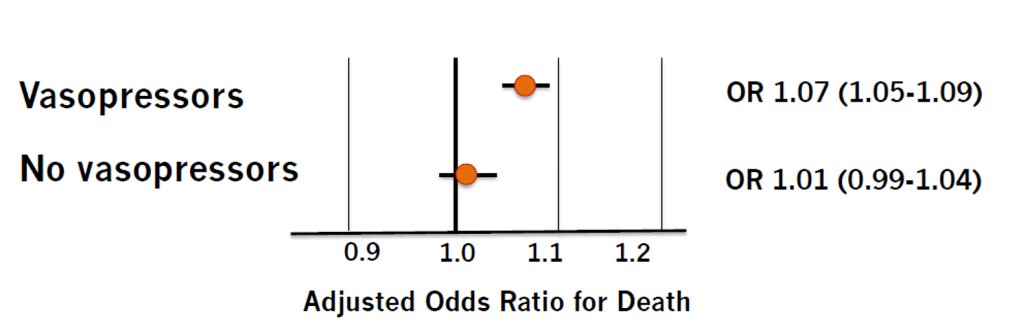
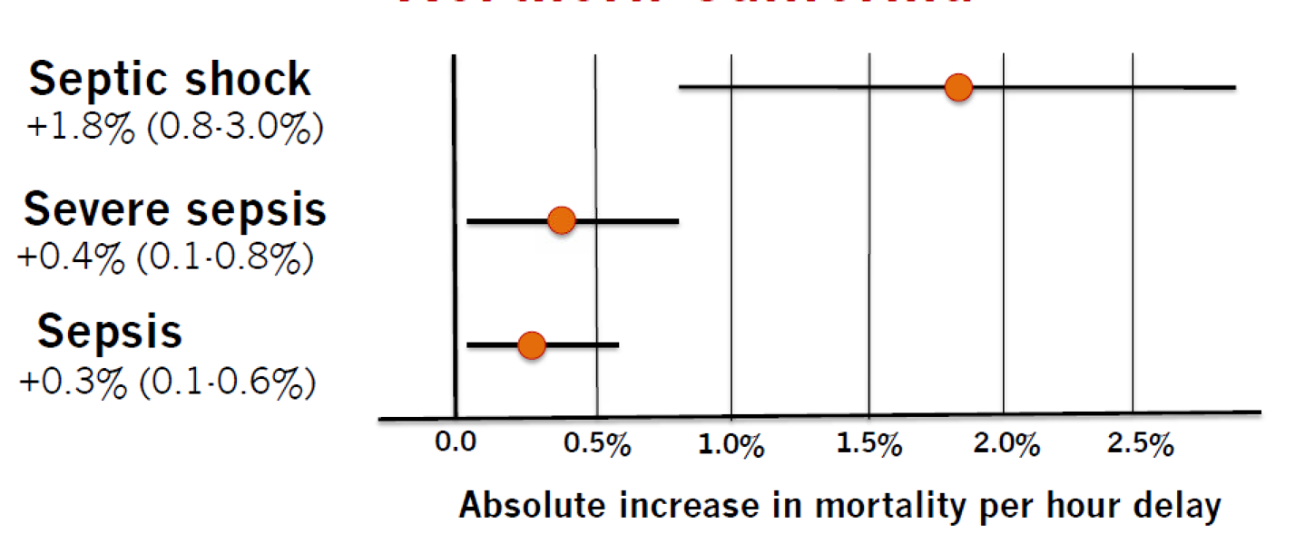
For early sepsis without septic shock the data are less compelling
Clin Infect Dis 2021;72:541.
“While early recognition and treatment are important goals, setting expectations for treating all patients with possible sepsis within 1 or even 3 hours of triage time, when most patients are still undifferentiated, risks driving antibiotic overuse.”

Slide 23
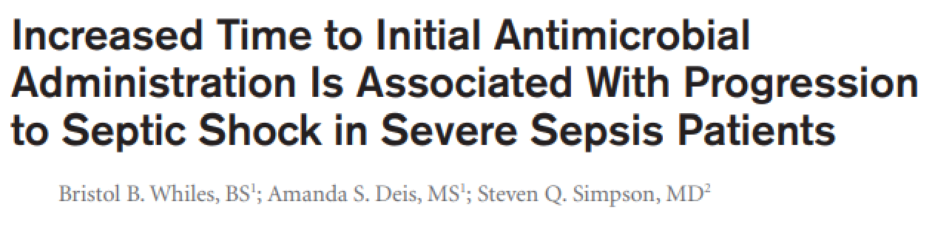
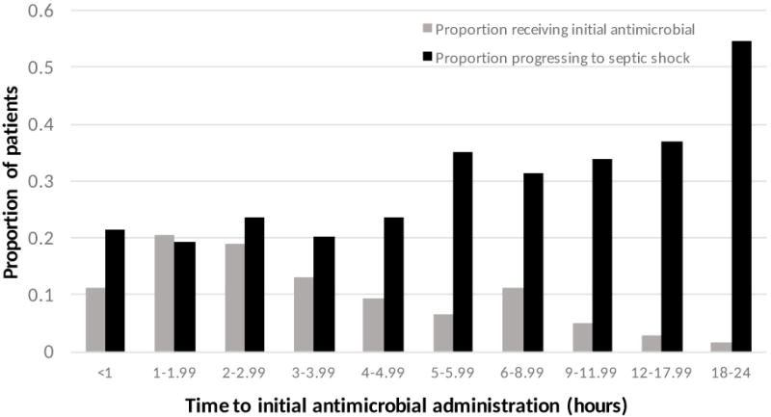
While delays in antibiotics can increase risk of progression to septic shock, this is really delays ≥5 hours
Crit Care Med 2017;45:623.

Slide 24
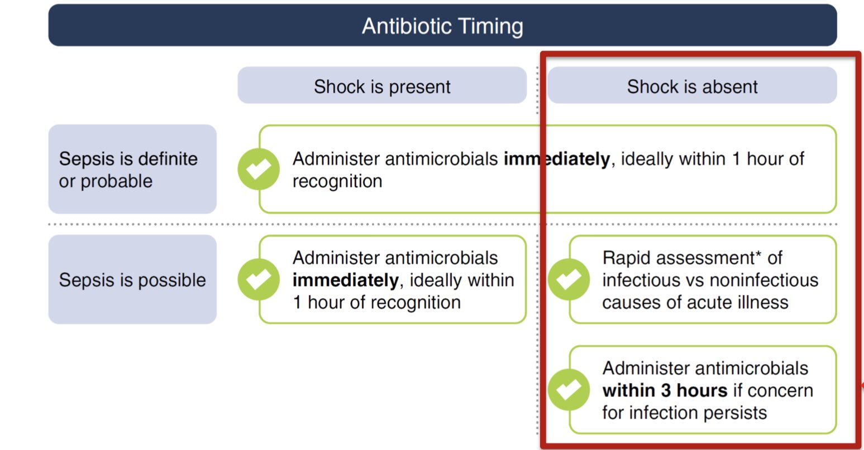

Data were incorporated into revised 2021 International Guidelines for Management of Sepsis and Septic Shock
Crit Care Med 2021;49:1974.

Slide 25
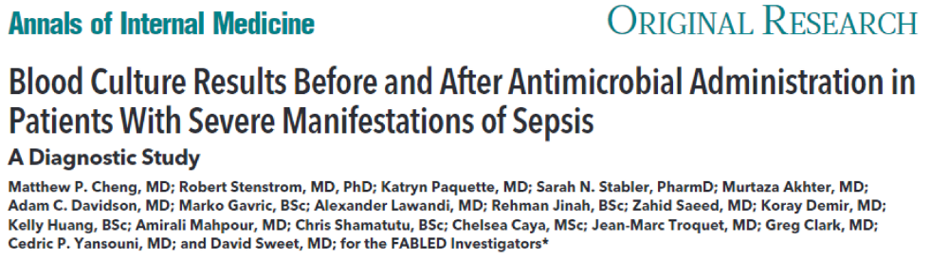
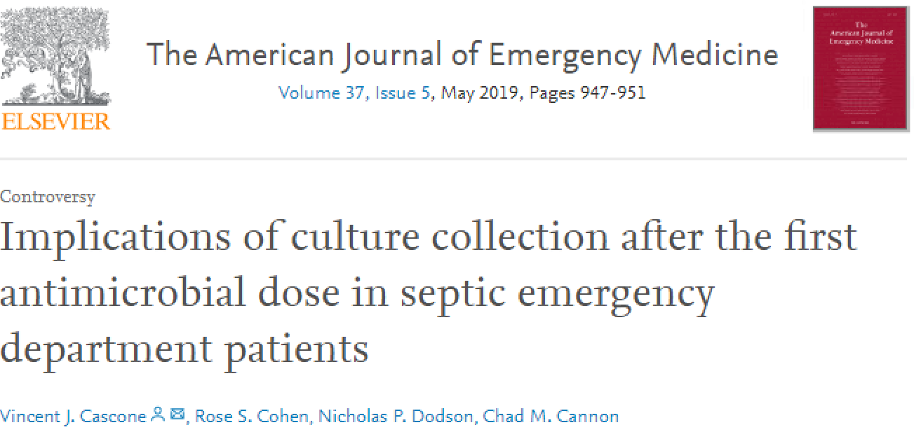
Part of this assessment includes blood cultures before antibiotics
For patients presenting with sepsis, administering antibiotics before obtaining blood cultures, even just 70 minutes (IQR 50-110 minutes) before, reduces sensitivity by 53% (half as likely to identify bacteremia, if present)
Sepsis patients who had cultures obtained after first administered dose of antibiotic trended toward longer ICU and hospital LOS, higher risk of C. difficile infection, and higher mortality
Ann Intern Med 2019;171:547.
Am J Emerg Med 2019;37:947.

Slide 26
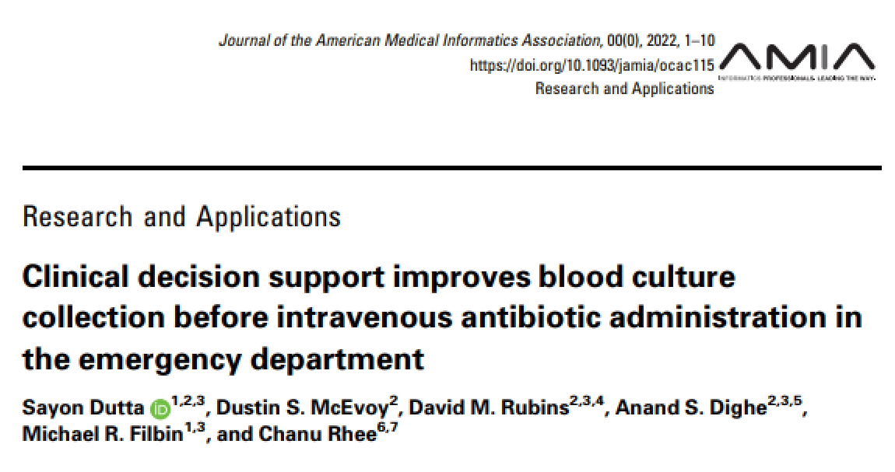
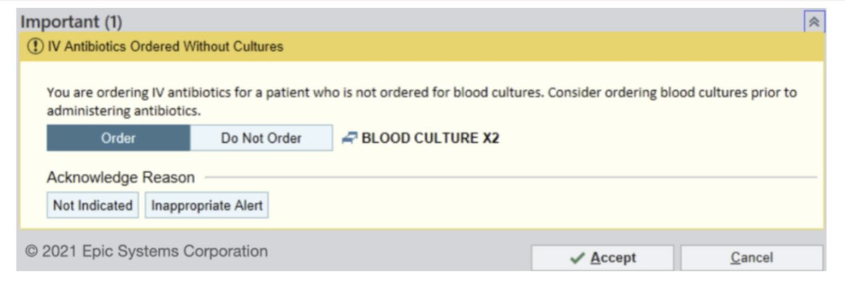
Consider a best practice alert to improve drawing blood cultures before antibiotic administration
J Am Med Inform Assoc 2022
(Dutta et al. On-Line Ahead of Print)

Slide 27
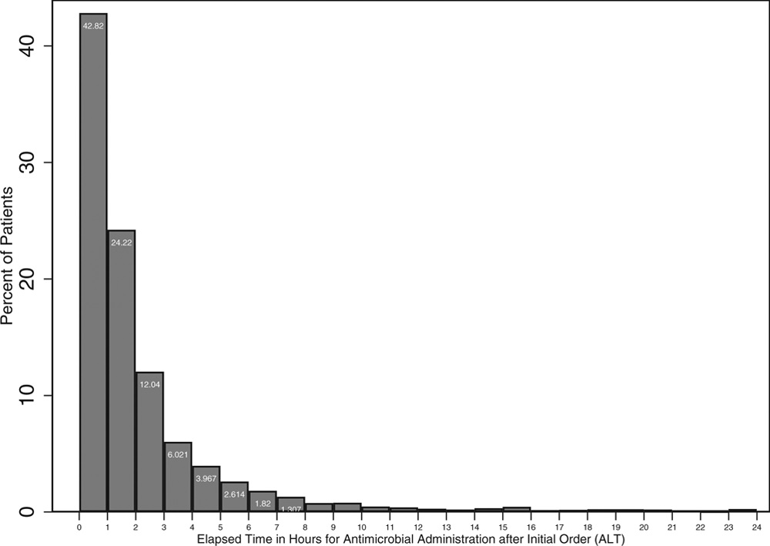
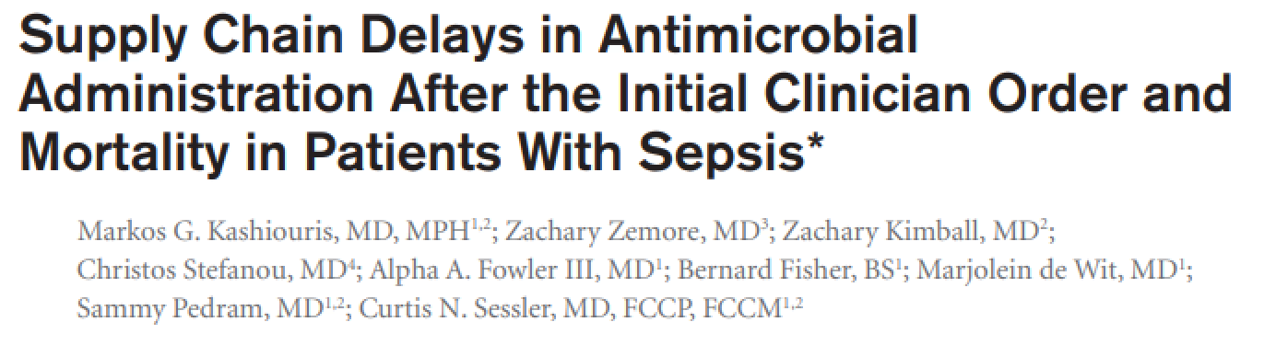
However, once the decision has been made to administer antibiotics, delays >1 hour between order and administration associated with higher mortality
OR (death at 28 days) = 1.28 [p 0.007], when 1-2 hour delay to administration
Crit Care Med 2019;47:1388.

Slide 28
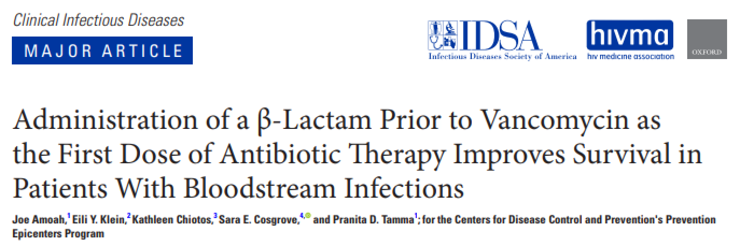
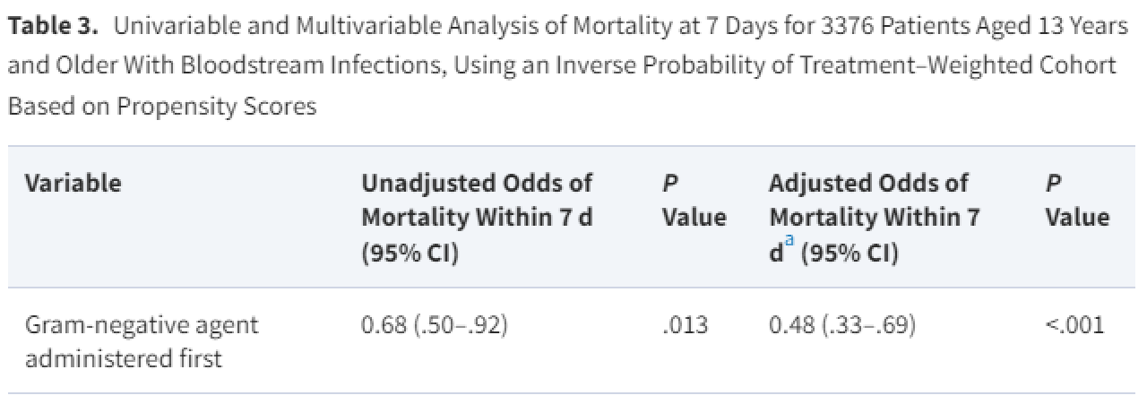
Also, if unable to administer concurrently, prioritizing administration of a beta-lactam prior to vancomycin improves 48 hour and 7 day mortality
Clin Infect Dis 2021
(Amoah et al. On-line Ahead of Print)
NOTE: True even if MRSA BSI (aOR 0.93, 0.33-2.63)

Slide 29
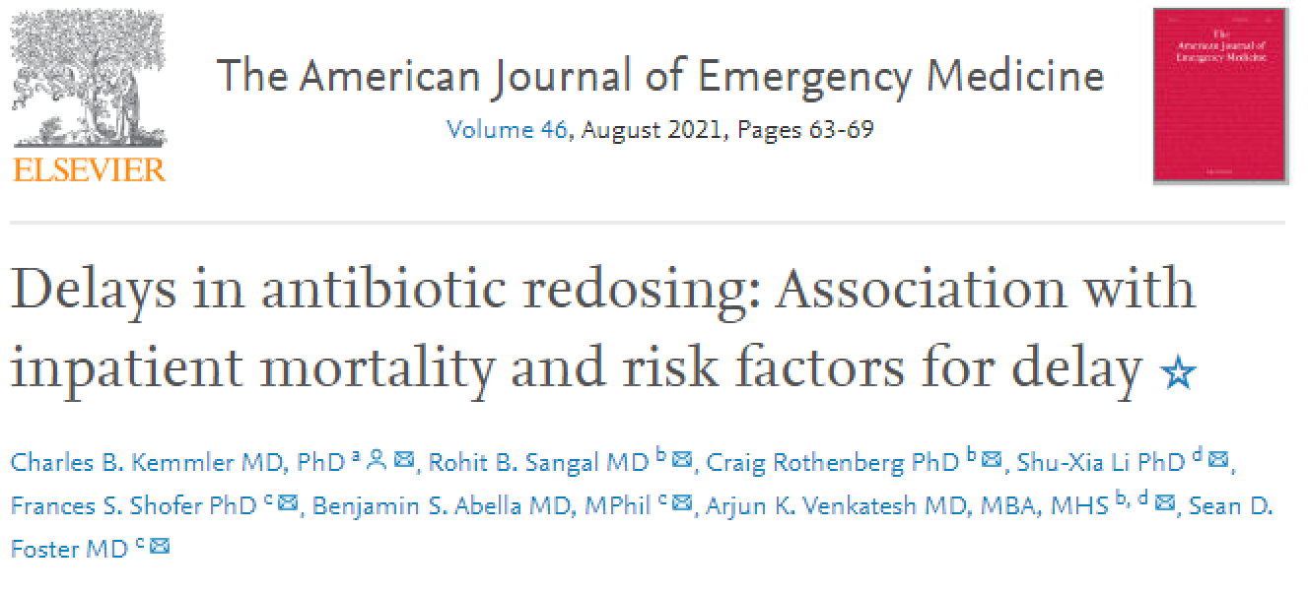
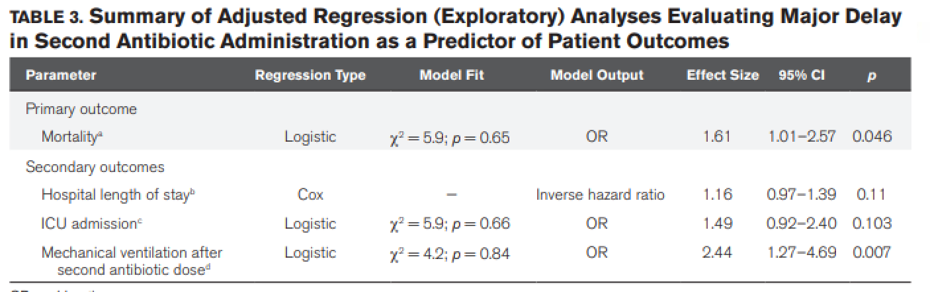
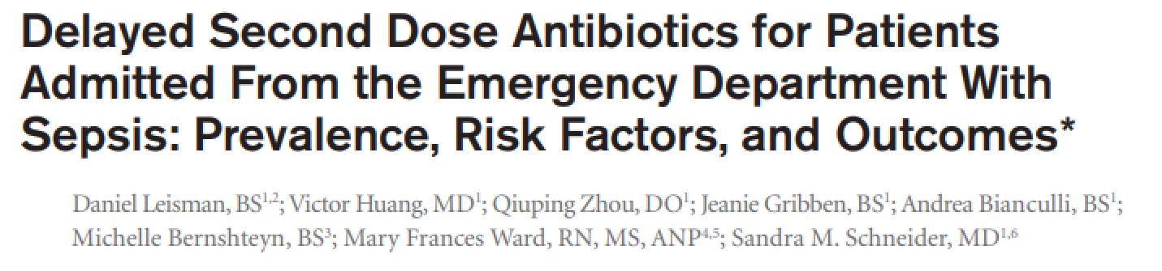
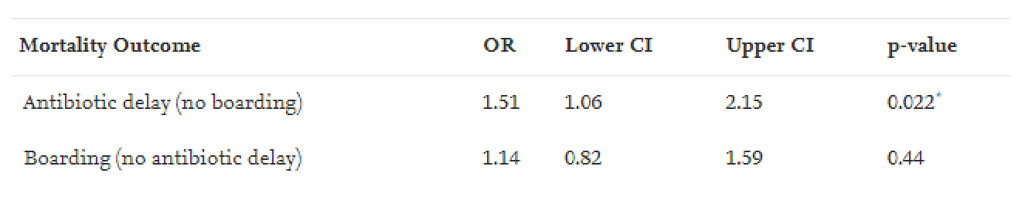
Finally, delays in second doses of antibiotics associated with increased mortality, length of stay, and mechanical ventilation requirement
Am J Emerg Med 2021;46:63.
Crit Care Med 2017;45:956.
NOTE: ED boarding was a predictor of delays in both studies.

Slide 30
Discussion
Medical Executive Committee

