Slide 1
Inpatient Management of Diabetes

Slide 2
Inpatient Management of Diabetes

Slide 3
Inpatient Management of Diabetes
Moderator
Ebrahim Barkoudah, MD, MPH, FACP, SFHM
Brigham and Women’s Hospital
Harvard Medical School
COI: Dr. Barkoudah reports research support payments from National Institutes of Health/National Heart, Lung, and Blood Institute, Bristol Myers Squibb and Janssen, payments made to Brigham and Women's Hospital for performing clinical endpoints sponsored by various entities, payments from WebMD and Advisory Board fees from Medscape, Janssen, Novartis, Pfizer, and travel expenses from Alexion. Editor in Chief, Journal of Clinical Outcomes Management

Slide 4
Attestation Disclosure to the Audience
The activity director(s), planning committee member(s), speaker(s), author(s) or anyone in a position to control the content for the Inpatient Management of Diabetes
NO financial interest or relationship which could be perceived as a real or apparent conflict of interest. There were no individuals in a position to control the content that refused to disclose.

Slide 5
Q1
Test

Slide 6
Q2
Test

Slide 7
Inpatient Management of Diabetes
Lily Ackermann, MD
Division of Hospital Medicine
Department of Medicine
Thomas Jefferson University
SHM Education Committee

Slide 8
Objectives For This Lecture
Basic principles of inpatient diabetes management and insulin dosing
What are the risks of Hyperglycemia?
  Landmark studies on inpatients
Review of ADA guidelines on inpatient glycemic targets
Steroid induced hyperglycemia
Enteral/Parenteral hyperglycemia
Newer classes of diabetes medications and indications (SGLT-2 inhibitors, GLP-1 agonists)

Slide 9
Managing Diabetes in the Hospital is Challenging
Difficulties in the hospital:
Variable nutritional intake
Need to change the diabetes home regimen
Acute illness, “stress-related” hyperglycemia

Slide 10
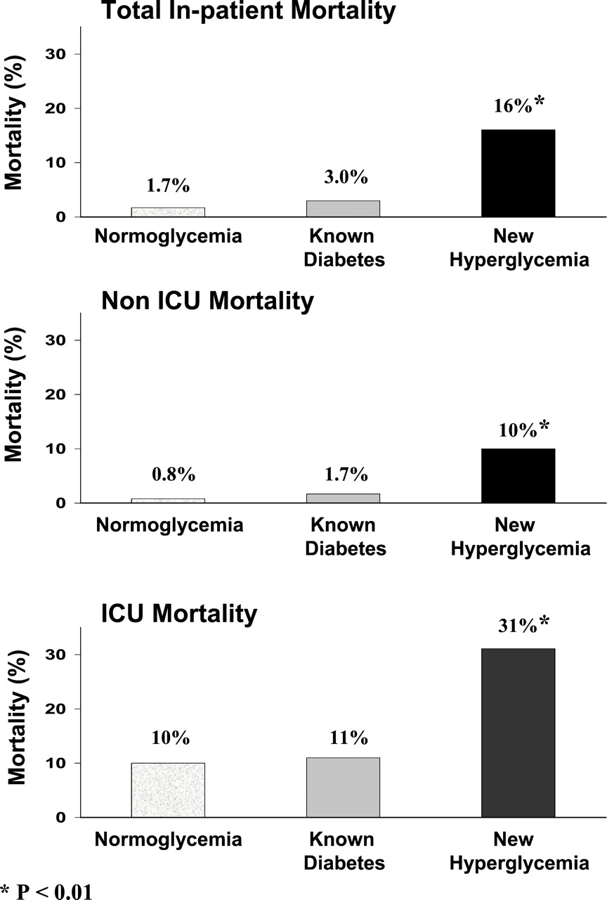
New Hyperglycemia vs Diabetes
In-hospital mortality
38% patients have new hyperglycemia
-higher mortality in those with new
Hyperglycemia
infections
Acute neuro events
In both ICU and general ward patients
Umpierrez et al, J Clin Endocrinol Metab, Volume 87, Issue 3, 2002: 978–982, https://doi.org/10.1210/jcem.87.3.8341

Slide 11
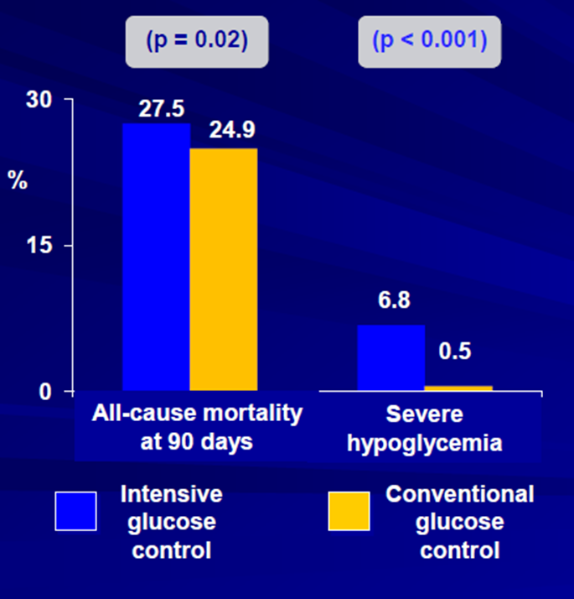

NICE- SUGAR Conclusions
Conclusion:
A blood glucose target of < 180 mg/dL resulted in a lower mortality than a blood glucose target of 81-108 mg/dl
“On the basis of our results we do not recommend use of the lower target in critically ill patients”
NICE-SUGAR Study Investigators, N Engl J Med. 2009 Mar 26;360(13):1283-97

Slide 12
How do we manage diabetes in the hospital?

Slide 13
GLYCEMIC GOALS
Goal for insulin treatment: 140-180 mg/dL
  110-140 only in critically ill, post surgical patients where hypoglycemia avoided
If 2 readings >180 in 24 hours, insulin should be added
Hypoglycemia Definitions:
  Level 1: 54-70 mg/dL
  *Level 2: < 54 mg/dL when symptoms begin
  *Level 3: altered mental and/or physical functioning, requiring assistance for recover
  *requires immediate correction of low blood glucose
American Diabetes Association Professional Practice Committee; Diabetes Care 1 January 2022; 45 (Supplement_1): S244–S253

Slide 14
Recommendations for Managing Patients With Diabetes in the Hospital Setting
Antihyperglycemic Therapy
Insulin
Recommended
OADs
Can continue in certain circumstances
IV Insulin
Critically ill patients in the ICU
SC Insulin
Non-critically ill patients
ACE/ADA Task Force on Inpatient Diabetes. Diabetes Care. 2006 & 2009 & 2002
2. Diabetes Care. 2009;31(suppl 1):S1-S110. 3. J Hosp Med 2008;3(Suppl.):29–41 4. Korytowski MT et al, JCEM, 107(8) 2022, pp2101-2128
Notes:
14

Slide 15
Most oral agents are relatively contraindicated during acute illness
Consider starting closer to discharge
Metformin is contraindicated with
  renal failure , GFR < 30 with IV contrast, symptomatic heart failure, hypoxia , acidosis
Thiazolidinediones are contraindicated with
  Fluid retention , Heart failure
Sulfonylureas can cause unpredictable and severe hypoglycemia
GLP-1 injectables can cause nausea, vomiting, and diarrhea
SGLT-2 can cause dehydration and euglycemic DKA, should be held 72h prior to major surgery
DPP-4 inhibitors are well tolerated
Umpierrez, GE et al. JCEM , 97 (1) 2012, pp 16–38
Korytowski MT et al, JCEM, 107(8) 2022, pp2101-2128

Slide 16
The Components of a
Physiologic Insulin Regimen
Basal insulin
  long-acting insulin required in all Type 1 (and most Type 2) patients to maintain euglycemia and preventing gluconeogenesis
  Glargine or detemir are preferred
Nutritional insulin
  scheduled short-acting insulin given just before a meal
  Rapid-acting insulin is preferred when patients are eating meals
  Regular insulin for severe gastroparesis, enteral feeding
Correctional insulin
  short-acting insulin that is given in addition to scheduled nutritional insulin (or given at other times of the day) to correct high blood glucose levels
  Does not prevent future high blood sugars
http://tools.hospitalmedicine.org/resource_rooms/imp_guides/GC/GC_Workbook.pdf

Slide 17
Which Patients Should be Treated with a Physiologic Insulin Regimen?
During hospitalization
Any patient with blood glucose levels consistently above the target range
Immediately at the time of admission
All patients with type 1 diabetes
Patients with type 2 diabetes if…
  they require insulin
  on high doses of oral agents that will be held
  poor control on high doses of oral agents
http://tools.hospitalmedicine.org/resource_rooms/imp_guides/GC/GC_Workbook.pdf

Slide 18
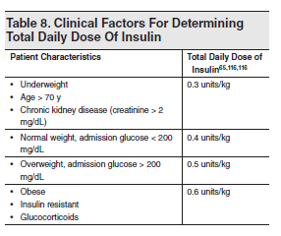
Estimate the Amount of Insulin the Patient Would Need Over One Day
Type 2 Diabetes
Type 1 Diabetes
½ basal
OR
0.25 U/kg

Slide 19
Principles of Basal and Bolus Insulin
Basal Insulin
Bolus Insulin
New to insulin: start glargine 0.15 - 0.2 units/kg
  Use 0.15 units/Kg for T1DM
  Use 0.10 units/Kg for elderly, renal failure, low BMI
OR 10 units glargine and titrate
  Avoid titrating glargine up too quickly as long acting insulin can take 2-3 days to reach steady state
Best way to judge dose is:
  When patient is NPO
  Change in blood sugar between bedtime and breakfast
  If changing by > 30 points adjust
Best way to judge dose is
  By the change in blood sugar between the meal it is given, and the next meal
  If changing by > 30 points adjust
Sliding scale insulin should guide changes
If intake is not very consistent, can dose prandial insulin after a meal, based on percent of meal eaten
http://tools.hospitalmedicine.org/resource_rooms/imp_guides/GC/GC_Workbook.pdf

Slide 20
What do you start first? Basal or Bolus?
Basal insulin with correction THEN scheduled nutritional insulin
Poor oral intake: Basal insulin with correction insulin regimen
Good intake: Basal insulin with correction then add bolus if needed
–Umpierrez et al Diabetes Care. 2013 Jul 22.
–Umpierrez et al Diabetes Care. 2013 Aug;36(8):2169-74

Slide 21
ADA: Correction of hyperglycemia
Basal insulin or a basal plus bolus correction insulin regimen is the preferred treatment for non–critically ill hospitalized patients with poor oral intake or those who are taking nothing by mouth. A
An insulin regimen with basal, prandial, and correction components is the preferred treatment for non–critically ill hospitalized patients with good nutritional intake. A
Use of only a sliding scale insulin regimen in the inpatient hospital setting is strongly discouraged. A
American Diabetes Association Professional Practice Committee; Diabetes Care 1 January 2022; 45 (Supplement_1): S244–S253.

Slide 22
Assess Blood Glucoses at Least Daily, Adjusting Insulin Doses as Appropriate
Hyperglycemia
  Use previous correction day scale and redistribute
  Adjust based on which values are elevated
  In general can increase by 10-20%
Hypoglycemia
  If hypoglycemic event, evaluate cause and adjust
  If under 100 mg/dL back off insulin by 10-20%
  Before increasing doses: make sure to check for:
  *missed insulin doses
  *excess snacking
  *timing of BG check
  *new infection
  *IVF with dextrose
http://tools.hospitalmedicine.org/resource_rooms/imp_guides/GC/GC_Workbook.pdf

Slide 23
Premixed Insulin (70-30 or 75-25) versus Basal-Bolus
Significantly increased hypoglycemia with premixed insulin for inpatients
Premixed insulin regimens are not routinely recommended for in-hospital use
Can convert to premixed insulin at discharge if want to send home on two injections a day instead of four
http://tools.hospitalmedicine.org/resource_rooms/imp_guides/GC/GC_Workbook.pdf

Slide 24
Enteral and Parenteral Nutrition
Vennard KC, Selen DJ, Gilbert MP. Endocr Pract. 2018;24(10):900-906. doi:10.4158/EP-2018-0150

Slide 25
Enteral and Parenteral Nutrition
Vennard KC, Selen DJ, Gilbert MP. Endocr Pract. 2018;24(10):900-906. doi:10.4158/EP-2018-0150

Slide 26
Steroid Induced Hyperglycemia
Aberer F,. J Clin Med. 2021 May 16;10(10):2154.

Slide 27
Aberer F,. J Clin Med. 2021 May 16;10(10):2154.

Slide 28
What to do at discharge?
Transition to home begins at admission
  Identify, monitor, and treat all pts with hyperglycemia
  HgA1c on all hyperglycemic pts if not checked recently
  Identify financial/social barriers to outpt management
  Emphasize nursing involvement and input
F/up within 1-2 weeks after discharge if treatment with antihyperglycemic medications initiated, stopped, or if dose change occurred
Arrange f/up newly diagnosed hyperglycemia
  *some may no longer have hyperglycemia after acute illness resolves
  *fasting BG should be reassessed 1-2 months or sooner following discharge
http://tools.hospitalmedicine.org/resource_rooms/imp_guides/GC/GC_Workbook.pdf

Slide 29
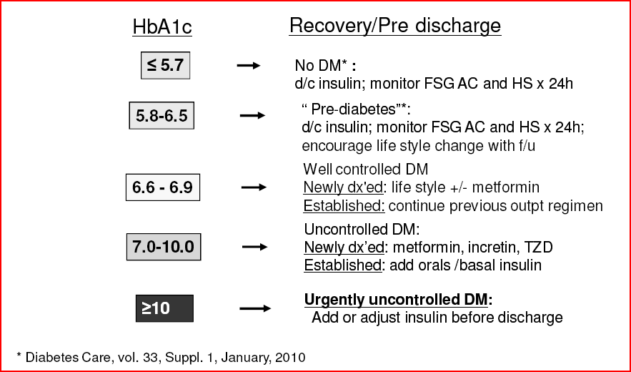
Use Admission HgA1c for DC

Slide 30
When to Consult
Type 1 Diabetes with labile FSG
Patients on insulin pumps
U-500 insulin
>2 glucose measurements > 300 mg/dl or recurrent hypoglycemia
Diabetes Care 27:553-591, 2004

Slide 31
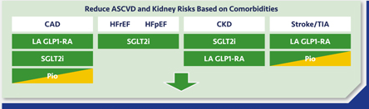

ADA Recommendations
Cardiovascular disease: SGLT-2 inhibitors or GLP-1 agonist with proven cardiovascular benefit
  GLP-1: Liraglutide, Semaglutide, Dulaglutide
CKD with GFR 30-50 ml/min or heart failure (HFrEF, HFpEF): SGLT-2 inhibitor
Favor GLP-1 agonist over insulin to reduce CV events
Handelsman G, et al. J Diabetes Complications. 2022 Feb;36(2):108101.

Slide 33
Inpatient Management of Diabetes
Guillermo Umpierrez, MD, CDE, FACE, MACP
Professor of Medicine, Division of Endocrinology, Metabolism Emory University School of Medicine
Chief, Diabetes and Endocrinology Grady Memorial Hospital Atlanta, Georgia

Slide 34
Poll Question

Slide 35
Answers
65 y M with 5y history of type 2 diabetes, admitted for CHF exacerbation (HFrEF); FSG 205- 245 mg/dL during the first 12 hours of admission, BMI 35, CKD 3 (eGFR 59 ml/min), Hgb A1C 1 month ago 7.8%, home medications are glipizide 10 mg BID and metformin 1000 mg BID. SaO2 88%, SBP 90/50, pt started on IV diuretic
What is the next step in the management of this patient?
Stop home diabetes medications and start correctional insulin dosing
Stop home diabetes medicine and start basal and rapid acting insulin with meals
Continue home diabetes medications and add correctional insulin
Add sitagliptin with correctional insulin
Hyperglycemia Symposium, Endocrine Society Clinical Practice Guideline, 2022, The Endocrine Society, https://bit.ly/3xJitYN .

Slide 36
Answers
65 y M with 5y history of type 2 diabetes, COPD, admitted for COPD exacerbation,
BMI 35, CKD 3 (eGFR 59 ml/min),home medications are glimepiride 2 mg/day and metformin 1000 mg BID. Patient currently on basal-bolus therapy with FSG 142-191 mg/dL. The next day prednisone 40 mg daily added for wheezing, now hyperglycemia (FSG 250-350).
What is the next step in the management of this patient?
Increase correctional dose insulin scale from low to moderate
Add home medications of metformin and glimepiride
Add a dose of NPH insulin given at the same time as the prednisone dose
Add GLP-1 Receptor agonist
Hyperglycemia Symposium, Endocrine Society Clinical Practice Guideline, 2022, The Endocrine Society, https://bit.ly/3xJitYN .

Slide 37
Discussion
Medical Executive Committee

