Slide 1
Scheduling 101: How to Create a Schedule That Works for Your Team
Shikha "Keika" Alqalaf, FHM
Dr. Tabatha Matthias, DO, MBA
Dr. Nathan Wanner, MD

Slide 2
Shikha "Keika" Alqalaf, FHM
10+ years in healthcare, including COO & CRO at a Private Hospitalist Group.
Bachelor's in Healthcare Management, AI in Healthcare certificate, MHA (2024 GO BIG RED!)
President, Society of Hospital Medicine, Charlotte Metro Area Chapter.
Founder, NeuralNet Consulting - an AI solutions consulting firm.
Fellow in Hospital Medicine for healthcare quality improvement commitment.

Slide 3
Dr. Tabatha Matthias, DO, MBA, FHM
University of Nebraska Medical Center Associate Division Chief of Clinical Operations
Assistant Professor, Division of Hospital Medicine
Acute Care Medical Director, Nebraska Medicine
Board certified in Internal Medicine, Hospitalist physician
Medical School: Kansas City University
MBA: Rockhurst University
Residency: Internal Medicine, Tripler Army Medical Center

Slide 4
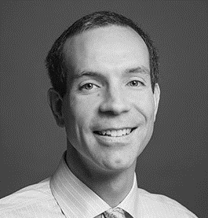
Dr. Nathan Wanner, MD
Director, University of Utah Hospital Medicine Section
Professor and Associate Division Chief, Division of General Internal Medicine
Inpatient Chief Value Officer, Department of Internal Medicine
Specialties: Hospital Medicine, Palliative Care
MD, Indiana University
Internal Medicine, University of Utah

Slide 5
Agenda
Introduction to 101 Resource
Presenter Introductions
Panel Discussion
Q&A
Pearls of Wisdom and Takeaways
Different Scheduling Models – Pros, Cons and Challenges

Slide 6
Resources for Scheduling

Slide 7
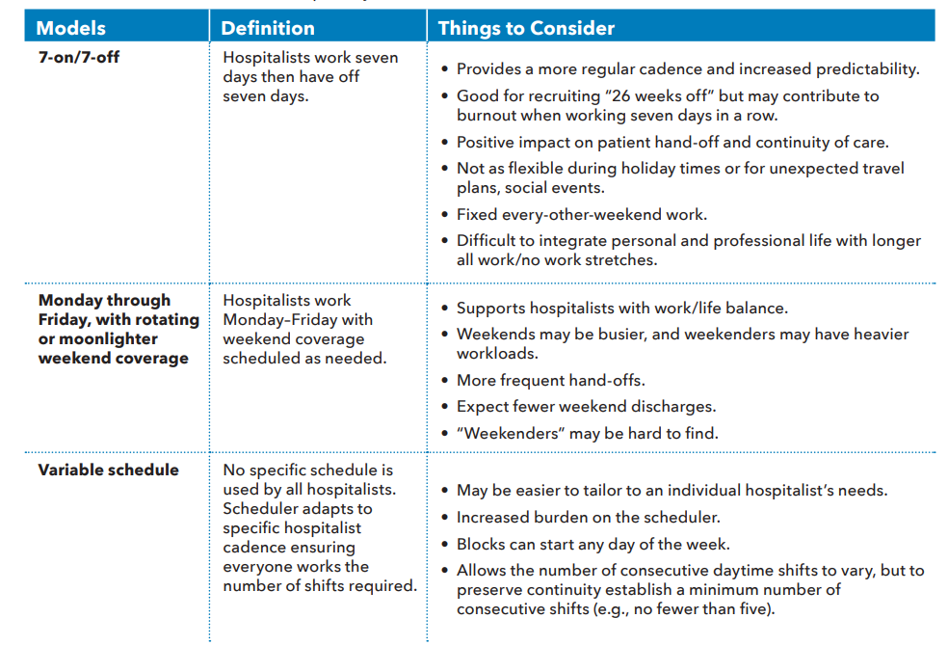

Slide 8
Panel Discussion
Discussion points:
Scheduling experiences in different hospital settings
Impact of schedule models on team efficiency and morale
Considerations when adapting schedule models for a specific hospital context

Slide 9
Community vs. Rural Hospitals
Community Hospitals: With more resources and higher patient volume, the 7 on/7 off model helps to maintain consistent care and manage workload efficiently.
Rural Hospitals: With fewer resources, the predictability of the 7 on/7 off schedule can assist in managing staffing needs and ensure adequate coverage at all times.

Slide 10
Positive Impact on Efficiency and Morale
Efficiency: The predictable pattern of the 7 on/7 off model helps to manage workload effectively, with each hospitalist aware of their responsibilities well in advance.
Morale: The distinct periods of work and rest contribute to higher job satisfaction and lower burnout rates among hospitalists.

Slide 11
My Experience
Effectiveness: In my years of creating schedules for hospitalists, I've found the 7 on/7 off model to be an efficient and effective way to ensure continuous patient care.
Preference: Many hospitalists I've worked with prefer this model due to its predictability and balance between work and personal life.

Slide 12
What Hospitalists Value
Work-Life Balance: The clear separation between work and time off can provide a significant boost to work-life balance.
Predictability: The cyclic and predictable nature of the 7 on/7 off schedule allows hospitalists to plan their personal and professional life effectively.

Slide 13
What Hospitals Value
Continuity of Care: This model ensures consistent patient care, with each hospitalist fully engaged during their "on" week.
Efficient Resource Utilization: By having a fixed schedule, hospitals can manage staffing needs and ensure adequate coverage at all times.

Slide 14
University of Nebraska Medicine Hospital Medicine
Large Academic Medical Center; Partnership UNMC & Nebraska Medicine
Two hospitals:
Nebraska Medicine Center, Tertiary/quaternary academic medical center
Bellevue Medical Center, Community based medical center
80 Physicians (~55 clinical FTE), 30 NP/PA
33 Physician shifts daily
14 NP/PA shifts daily (Similar model to physicians but scheduled separately)

Slide 15
UNMC Values
FLEXIBILITY
Teamwork
Variety of Shifts
Efficient patient care
Educating learners

Slide 16
How UNMC HM Schedules:
Each shift is assigned a Shift Value Unit (SVU):
Day/Swing- 1.0 SVU
Nights- 1.5 SVU
Each Physician is assigned a total number of SVU to achieve per fiscal year based on clinical FTE.
Early March- Schedule Survey: Each individual ranks the shifts (preferred, flexible, least preferred), holiday preferred to work, interest in moonlighting, and share any other information that would impact their scheduling (i.e. prolonged vacations, family changes).
After survey is completed, Preferences & Off Requests are placed into our scheduling platform.

Slide 17
How UNMC Schedules:
Each physician is scheduled based on:
Personal Off Requests
Personal Shift Preferences: Targeting 80% of preferred shifts & 20% shifts to fill the schedule.
Needs, preferences, and Off Requests of the other 80+ physicians in our group.
We have a detailed scheduling guidelines document that outlines:
SVU for each shift
Scheduling process
Assigned priority for shifts that are most preferred by the entire group
Expectations for Swaps and picking up Available shifts

Slide 18
How UNMC Schedules:
Scheduling platform creates a preliminary schedule
Office Admin Associate and Associate Division Chief Review and make changes
Quarterly Schedules created: July-Sept, Oct-Dec, then January-June released together.
Schedule is released, physicians review
Schedule changes are made based on physician review & schedule is "finalized"
After finalized schedule released, physicians swap shifts on their own if there are scheduling changes needed.
Lots of support is provided continuously by our scheduling administrative associate for changes that arise

Slide 19
Pros and Cons
Pros:
Can accommodate individuals needs and preferences.
Schedulers know each individual & their needs
Mentality of "We can work anything out"; Everyone is flexible, willingness to help each other out
Job satisfaction, low burnout
Moonlighting opportunities
Scheduling platform allows for auditing and shift equity analysis
Cons:
Time consuming to account for each person's preferences & time off requests
Expensive scheduling platform, admin associate, & physician leader time
Preserving continuity of patient care can become a challenge
No scheduling predictability

Slide 20
Who We Are: University of Utah Hospital Medicine
Academic medical center and tertiary referral hospital serving a large geographic footprint
Very mature and stable group with low turnover
3 practice settings
University of Utah Hospital
Huntsman Cancer Hospital
Mountain West Medical Center
51 MD, 30 NP/PA
Small number of purely clinical physicians

Slide 21
What We Value
•Fairness and transparency
•Flexibility
•Reasonable workday
•Continuity
•Ability to plan

Slide 22
How We Schedule
Total number and types of shifts per year based on clinical FTE
Different weight of shifts and definition of 1.0 FTE depending on role (point system)
University of Utah Hospital
Huntsman Cancer Hospital
Mountain West Medical Center
Nocturnist
Individuals may do a mix of multiple roles
Schedule made out 6 months at a time

Slide 23
How We Schedule
Schedule preference survey emailed to everyone asking for preferences:
Practice site
Time off requests
Holiday preferences
Block length preferences (housestaff and non-housestaff)
Specific shifts
Other comments and opportunity for trades
Program Manager manually creates a schedule draft based on total shift requirement for different types of shifts
Variable mix of practice site, shift type, block length, start date, weekday to weekend ratio, etc.
Director reviews schedule draft
Schedule draft is posted for all providers to review
Program Manager addresses important concerns as able before finalizing

Slide 24
Pros
Flexibility
Practice site
Type of shift
Start date
Block length
Days off
Continuity – not much switching after the schedule is made
Human element
Building trust

Slide 25
Cons
Complex
Stressful and time-consuming for the people doing the scheduling
“There are many scheduling tools available, but it is inevitably a very manual and time-consuming process”
“A 7-on/7-off schedule built every 12 months is quite easy to create but may need to be maintained and updated more often than a variable schedule built quarterly”
Sometimes challenging maintaining consistency in the flow of the schedule (on/off cycle)
Human element
Possible concern regarding favoritism

Slide 26
Questions and Answers
We're open to any questions, suggestions, or experiences you'd like to share. Please feel free to ask us anything related to hospitalist scheduling. Your input is invaluable in this learning and sharing process.
If you would like to ask a question, you can either type your question using the Q&A feature at the bottom of your screen or raise your hand and we will unmute you.

Slide 27
Pearls of Wisdom and Takeaways
Importance of effective scheduling in a hospital setting
Pros, cons, and challenges of different schedule models
Key factors to consider when designing a schedule for hospitalist teams
Shared insights from open discussion

Slide 28
7 on / 7 off or “Fixed” Schedule Model
Description: The Fixed Schedule Model refers to a structure where hospitalists follow predetermined shifts. This typically entails a rhythmic cycle, such as a 7 days on, 7 days off pattern, resulting in approximately 182 working days annually.
PROS | CONS | CHALLENGES
Predictability - Staff can plan their personal lives around their work schedule. Consistency - The same team members work together regularly, promoting teamwork and improving communication. Easier to manage - Scheduling becomes less complicated as shifts do not change. | Limited flexibility - Staff may not be able to adjust their schedules for personal needs or emergencies. Risk of burnout - Constantly working the same shifts can lead to fatigue and burnout. Coverage gaps - Fixed schedules can result in uncovered shifts, particularly during holidays or sick days. | Balancing individual preferences with hospital needs. Ensuring even distribution of more challenging shifts.

Slide 29
Mon-Fri, w/ Rotating or Moonlighter Weekend Coverage or “Rotating” Schedule Model
Description: In a Rotating Schedule Model, hospitalists rotate between day and night shifts, and between weekdays and weekends. For example, a hospitalist may work day shifts for a month, then switch to night shifts for the next month.
PROS | CONS | CHALLENGES
Fairness - All staff experience a variety of shifts, which can increase feelings of equity. Flexibility - Allows staff to experience different routines, which can alleviate boredom and burnout. Coverage - Helps ensure round-the-clock patient coverage. | Disrupted sleep - Regularly changing between day and night shifts can disrupt sleep patterns and negatively impact health. Inconsistent team dynamics - Regular changes in shift partners can hinder the development of solid team relationships. Complicated to manage - Requires careful planning to ensure all shifts are covered and rotations are fair. | Managing the health and wellbeing of staff amidst rotating shifts. Maintaining effective communication and team dynamics despite regular changes in shift partners.

Slide 30
Variable Schedule or “Flexible” Schedule Model
Description: A Flexible Schedule Model allows hospitalists to have some control over their schedule, within certain boundaries. For example, hospitalists might choose their preferred shifts a few months in advance.
PROS | CONS | CHALLENGES
Flexibility - Staff have more control over their schedules, allowing for better work-life balance. Motivation - Staff satisfaction often increases due to perceived control over work hours. Potential for increased coverage - More willingness to pick up additional shifts. | Complexity - Requires more administrative oversight and careful management to ensure all shifts are covered. Potential for inequity - More popular shifts may consistently go to certain staff, leading to perceived or actual inequities. Inconsistent team dynamics - Like rotating schedules, teams may frequently change, affecting cohesion. | Ensuring fairness in shift allocation. Maintaining a consistent standard of patient care despite varied schedules.

Slide 31
Have more questions?
Continue the Conversation on HMX!
Shikha "Keika" Alqalaf, FHM
Alqalaf@NeuralNetHealthcare.com
Dr. Tabatha Holtz Matthias, DO
tabatha.matthias@unmc.edu
Dr. Nathan Wanner, MD
nathan.wanner@hsc.utah.edu

Slide 32
Upcoming Webinars
Register for our upcoming Backup Systems webinar Tuesday, September 12th 2-3pm EST
Be on the lookout for a future webinar about the 2023 State of Hospital Medicine Report – more details to come!

Slide 33
The 2023 State of Hospital Medicine Report
The 2023 State of Hospital Medicine Report is coming soon!
The report includes the most recent data on practice demographics, staffing levels, turnover, staff growth, compensation models, and financial support for solid evidence-based management decisions from across the country.
New to the 2023 SoHM Report:
Expanded data on scope of services
Expanded data on staffing and scheduling models
Staffing changes and flexibility post-COVID
Well-being and burnout
Data from the inaugural Hospital Medicine Workforce Experience Survey
Notes:
The latest State of Hospital Medicine Report is coming soon! After a hiatus last year due to the ongoing affects of COVID-19, the report is the first set of data since the onset of the pandemic in 2020. The report includes the most recent data on practice demographics, staffing levels, turnover, staff growth, compensation models, and financial support for solid evidence-based management decisions from across the country. In addition to the data from the Medical Group Management Association’s Physician Compensation and Production Survey, the 2023 SoHM Report will also include data from SHM’s inaugural Workforce Experience Survey, which collected individual hospital data on patient census, backup systems, and well-being. The report is available for preorder now and will be available later this summer.

Slide 34
Thank you!!!

